Slide 1


Project VI – CAN elevator: diagnostics and control design Project
By: Justin Turcotte, Daniel Dreise, Brandon Harkness, Troy Annette

Slide 2
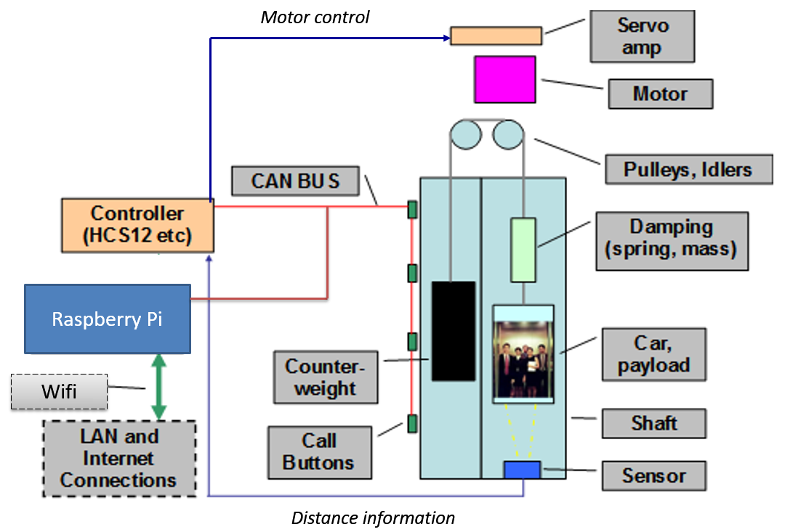
Contents
Project Purpose
Project Description
Network Overview
Data Flow Diagram
Phase 1
Controller Area Network (CAN)
Graphical User Interface (GUI)
Phase 2
User Interface Access and Connection
User interface action buttons & icons
user interface & repository capable of logging
Phase 3
Elevator state machine
PC-CAN Communication
PC-CAN Diagnostics
Unique feature – audio description

Slide 3
Project purpose
To study and apply design principles regarding networked systems.
More specifically:
To gain practical knowledge of the implementation and integration of various systems including: databases, industry-standard data networks, clients and remote servers, webpage design and interaction, & data logging and diagnostics.

Slide 4
Project Description
To remotely control an elevator and display diagnostics information by leveraging the design and implementation of
A Controller Area Network
A server with a database
A Graphical User Interface (a webpage)
The integration of various networked systems (LAN, CAN, Internet)

Slide 5
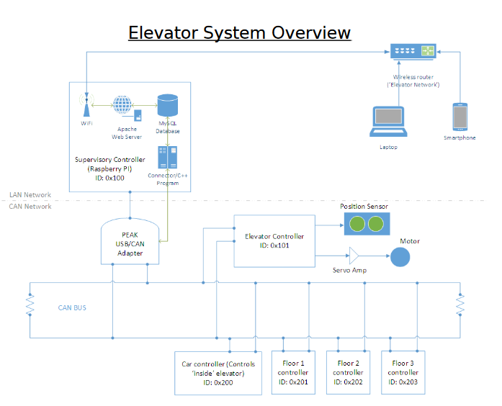
Design

Slide 6
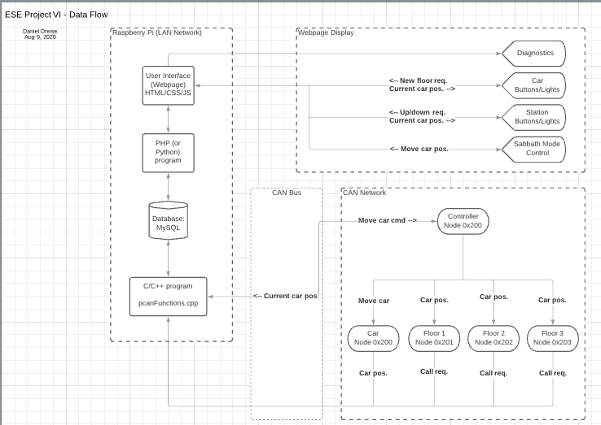
Data flow diagram

Slide 7
Phase 1

Slide 8
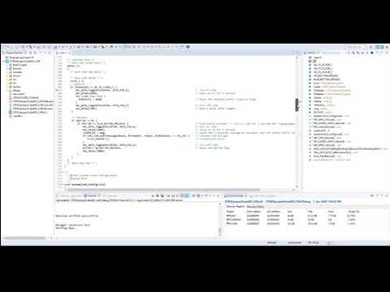
Elevator system CAN network
There is 1 CAN node per floor ("call-station")
Each call-station is equipped with up/down switches
Elevator car is equipped with floors 1,2,3 selection switches
Capable of detecting the location of the elevator via distance sensor
Capable of detecting up/down requests at any floor & switch
Capable of detecting floor selection from within the elevator

Slide 9
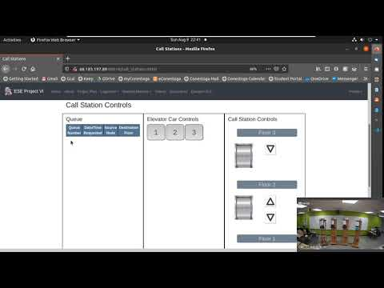
Elevator system gui design
GUI capable of displaying current location of the elevator
https://youtu.be/8cApqjhLs5s\

Slide 10
Phase 2

Slide 11
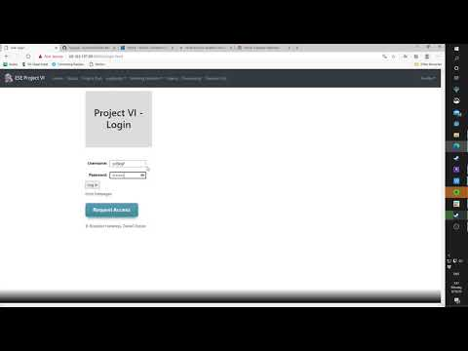
User interface access & Connection
User interface only accessible by privileged users through a login
User interface accessible from any device, using the appropriate URL
https://youtu.be/Rb8ReiIAhCk

Slide 12
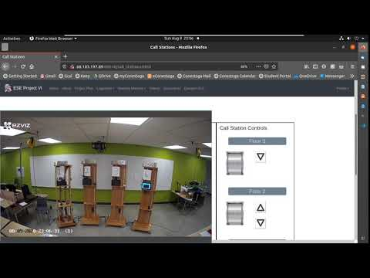
User interface action buttons & icons
User interface features floor buttons for floors 1,2, and 3
User interface features call buttons for up/down directions on appropriate floors
Ex: Floor 1 only requests up while floor 2 requests up and down
https://youtu.be/5LxxYfMAxlI

Slide 13
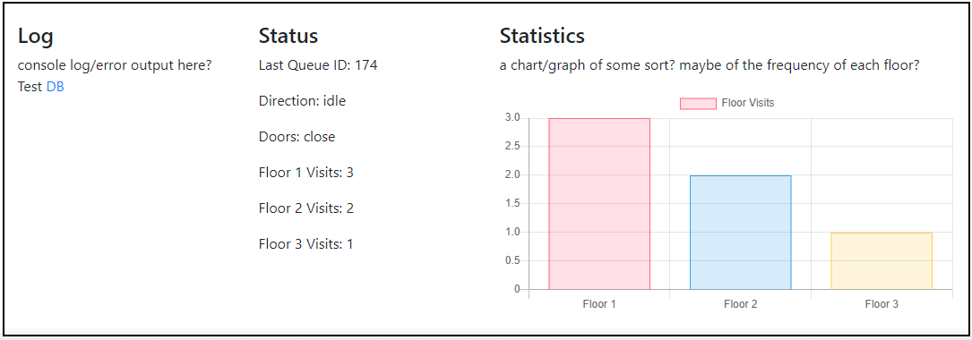
user interface & repository capable of logging
Diagnostics capable of logging & displaying to the user:
Total number of requests
The number of times each floor has been visited
Which floor the elevator is on
If the elevator moving up or down
If the doors opened or closed

Slide 14
Phase 3

Slide 15
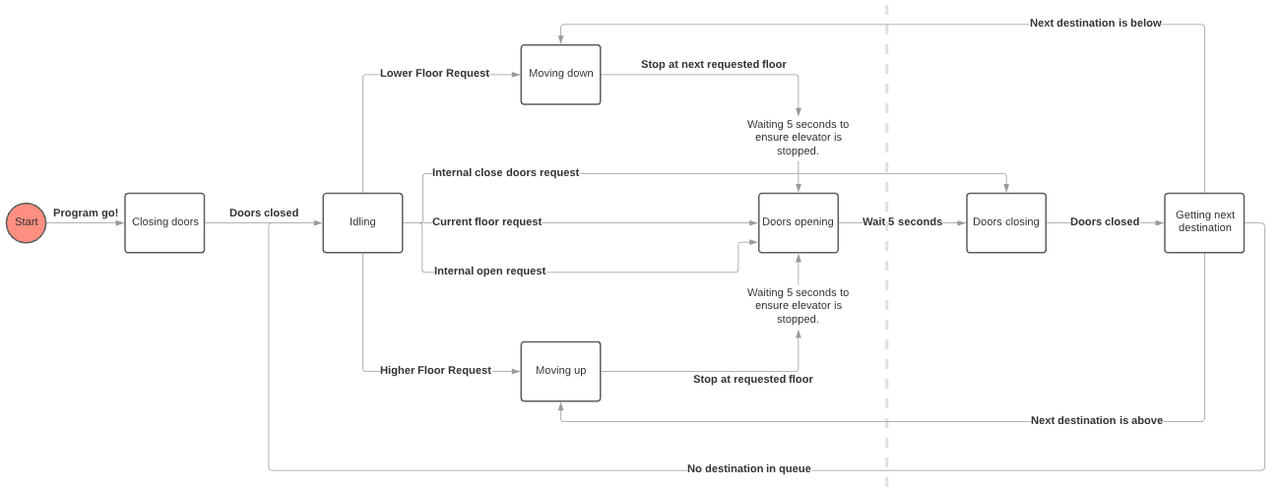
Elevator state machine
The finite state machine is based on the requested floors, the direction the elevator is moving as well as the state of the doors.
Delays so that people can enter, and exit are accounted for.

Slide 16
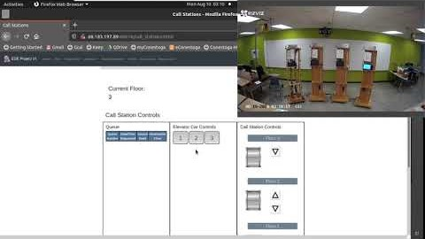
State logic / PC-CAN Communication
The elevator will move to the requested floor or call button.
Multiple floors can be queued & the elevator will move appropriately, stopping at floors along the way.
https://youtu.be/MO0S5KKlCuc

Slide 17
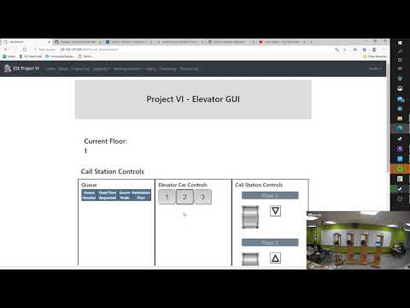
PC-CAN Diagnostics
Once a floor has been requested, the appropriate diagnostic table is updated – keeps track of the number of times a floor is requested.
Other factors are displayed for the user:
Total requests
Floor
Direction
Door state
Numerical output of the number of times each floor has been visited
https://youtu.be/T6Tpw0KQ6rM

Slide 18
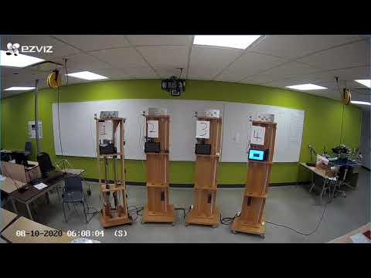
Unique feature – audio description
The elevator will announce arrival to each floor.
Ex: "*DING* Floor 3"
The elevator will announce doors opening/closing.
Ex: "*DING* Doors opening"
The elevator will announce ascending/descending.
Ex: "*DING* Elevator ascending"
The elevator will play some ambient music when idle.
https://youtu.be/rvHhyLy4Zbs

Slide 19
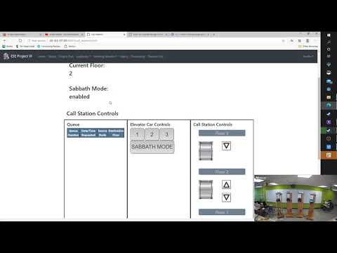
Sabbath mode
When enabled, elevator moves from floor to floor without any user input.
Order is 1->2->3->2->1...
https://youtu.be/jU38srUYT44

Slide 20
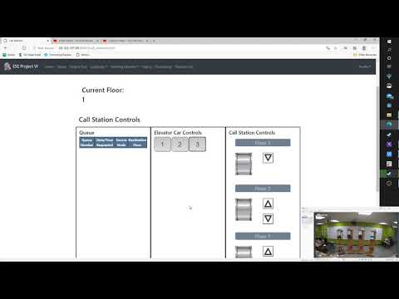
Complete project demo
Project Repo:
https://github.com/ddreise/SoftwareEngineering
Link to video:
https://youtu.be/-ffnf9d-77E

